Slide 1


Karolis Kajėnas
Notes:
What are collections? Does that makes sense? Give an example of collection in real life or C#.

Slide 2
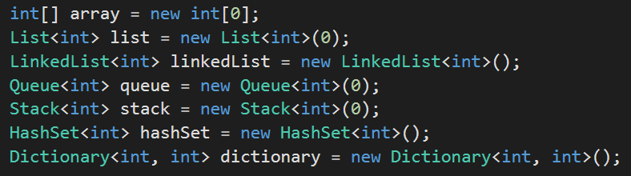
Collections in C#
Notes:
Collections in C#

Slide 3

Notes:
Queues

Slide 4

Notes:
Why snake game makes sense?

Slide 5
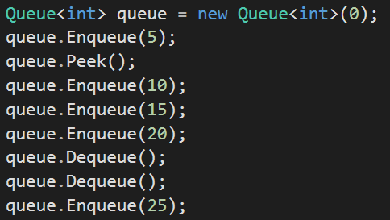
Queue in C#
Notes:
Queues in C# 15,20,25

Slide 6

Notes:
Stack of Cubes

Slide 7
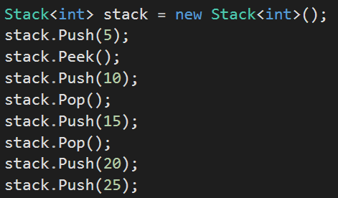
Stack in C#
Notes:
Stacks 25,25,5

Slide 8


Slide 9
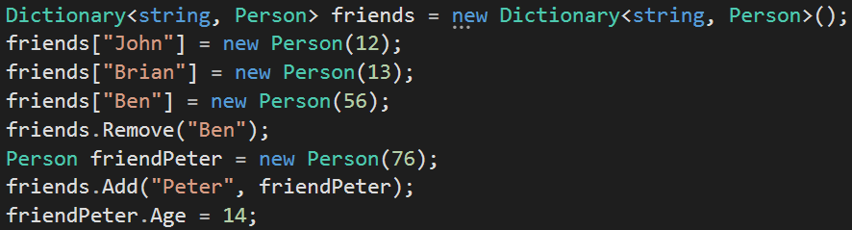
Dictionary in C#
Notes:
John – 12; Brian – 13; Peter – 14; Indexes mention. Explain hashes on board.

Slide 10


Slide 11

Notes:
Why not arrays? When to use each collection.

